Slide 1
VA.gov Content Style Guide Working Group 12/20/2018 agenda
Agenda
Doodle poll follow-up: Coordinator role
Draft charter
Standardize this!
Style guides inventory – primary; outdated; deprecated; missing?
December 20, 2018
Jennifer Lee, Content, DSVA, Jennifer.lee27@va.gov

Slide 2
Using words consistently inspires trust and confidence in our customers.

Slide 3
It creates a feeling that we’re competent, professional, and act on our customers’ behalf as a unified organization.

Slide 4

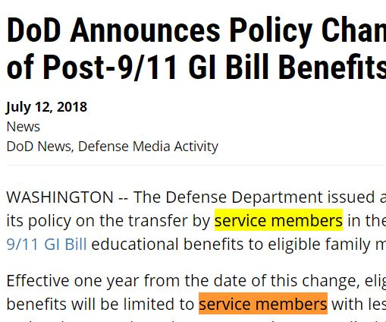
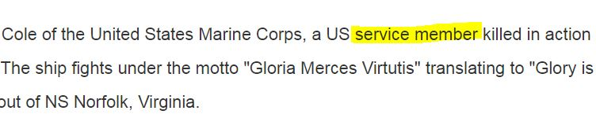
DOD doesn’t appear to have a standard, or if it does, does not use it consistently
https://www.militaryfactory.com/dictionary/military-terms-defined.asp?term_id=2948 – Service member
https://www.militaryfactory.com/dictionary/military-terms-defined.asp?term_id=439 – Service member
https://www.militaryfactory.com/ships/detail.asp?ship_id=USS-Cole-DDG67 – service member
https://www.militaryfactory.com/5-star-generals.asp - service member
https://dod.defense.gov/News/Article/Article/1573240/dod-announces-policy-change-on-transfer-of-post-911-gi-bill-benefits/ - service member

Slide 5

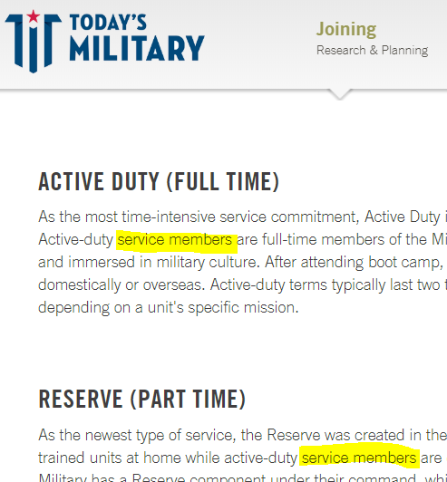
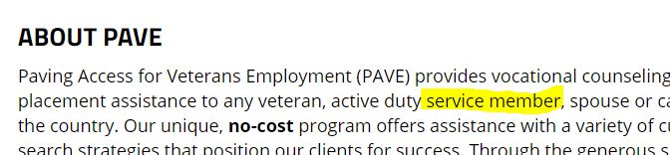
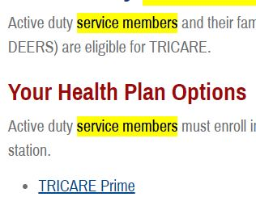
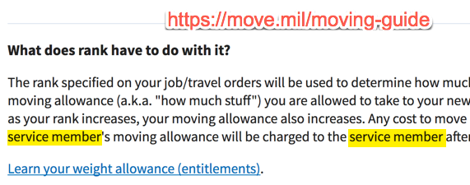
Outside VA and DOD
Paralyzed Veterans of America https://www.pva.org/veterans-employment
Today’s Military https://www.todaysmilitary.com/joining/types-of-military-service
Tricare https://www.tricare.mil/Plans/Eligibility/ADSMandFamilies
USA.gov https://www.usa.gov/military-personnel-and-installations
Move.mil https://move.mil/moving-guide
Notes:
Non-gov sites seem to use standard “service member,” but usa.gov uses “servicemember.”

Slide 6
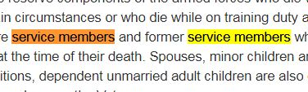
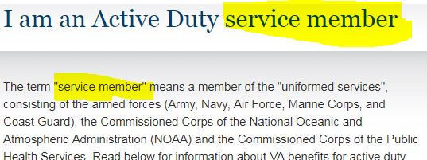
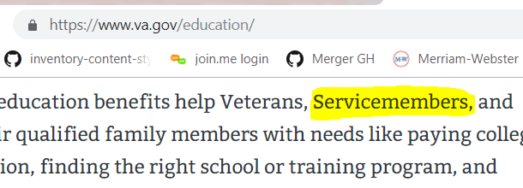
VA web properties, pages Sometimes “Servicemember,” “Service member,” “servicemember,” and “service member”
https://www.cem.va.gov/pre-need/
https://www.va.gov/opa/persona/active_duty.asp
https://www.va.gov/education/

Slide 7
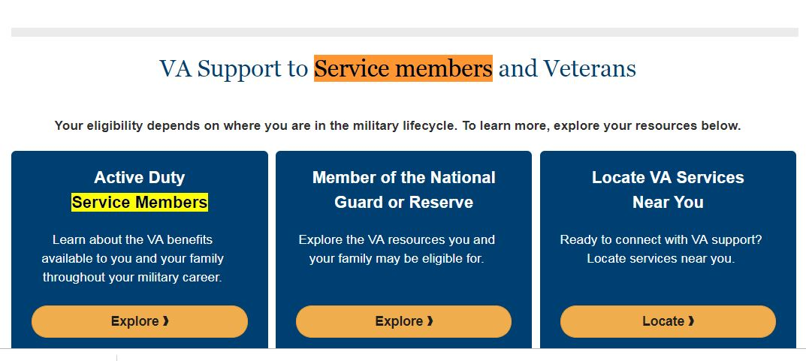
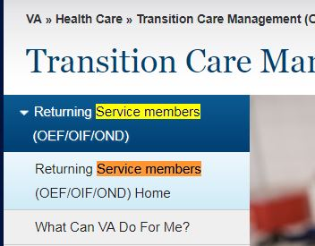
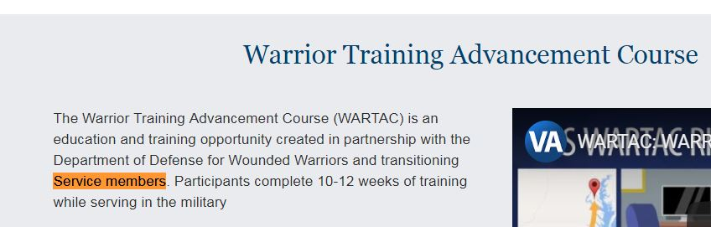
VA web properties, pages Sometimes “Servicemember,” “Service member,” “servicemember,” and “service member”
https://www.benefits.va.gov/tap/tap-index.asp
https://www.oefoif.va.gov/

Slide 8
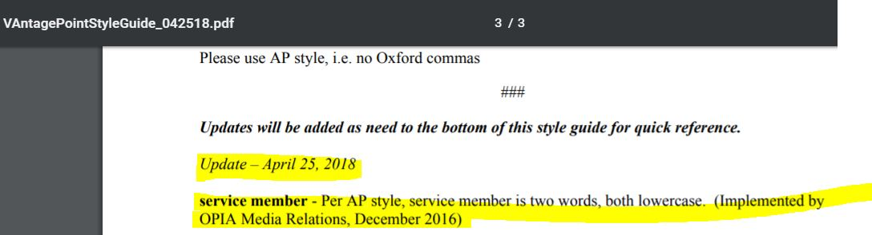
VAntagePointStyleGuide_042518.pdf: https://www.vapulse.net/docs/DOC-156855

Slide 9
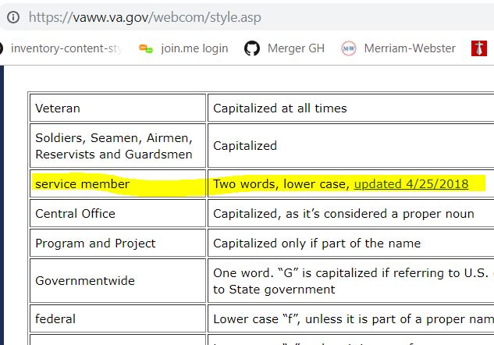
VHA Digital Media intranet: https://vaww.va.gov/webcom/style.asp

Slide 10
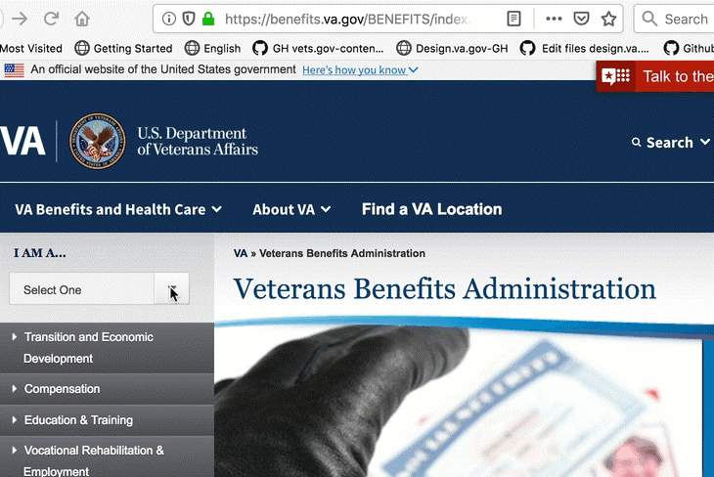
VBA points to OPIA “service member” page

Slide 11
A more modern, standardized, and plain language direction aligned with VA’s Digital Modernization Strategy
service members – lowercase, two words [no change but clarify for VA.gov]
Veterans – capitalized [no change]
family members – lowercase [no change]
spouses, dependents, survivors (and other family beneficiary terminology) – lowercase [no change]
caregivers – lowercase [no change]
health care – lowercase, two words [no change]
Exception: In branded names (such as the official names of VAMCs, forms, programs, etc.), defer to the branded style.

Slide 12
Using words consistently inspires trust and confidence in our customers.

Slide 14
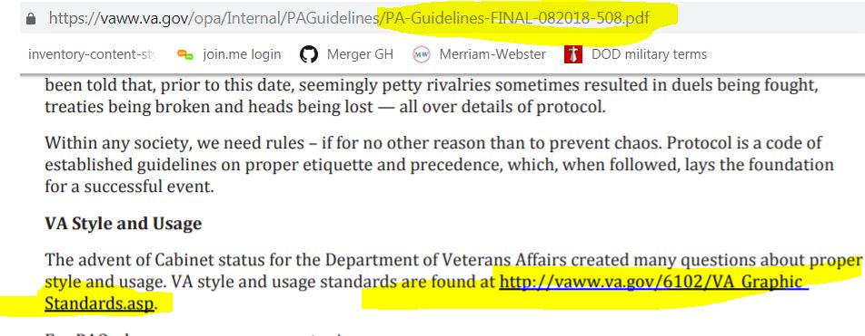
Public Affairs Guidelines -- for Facility Public Affairs Practitioners, pp 115 https://vaww.va.gov/opa/Internal/PAGuidelines/PA-Guidelines-FINAL-082018-508.pdf

Slide 15
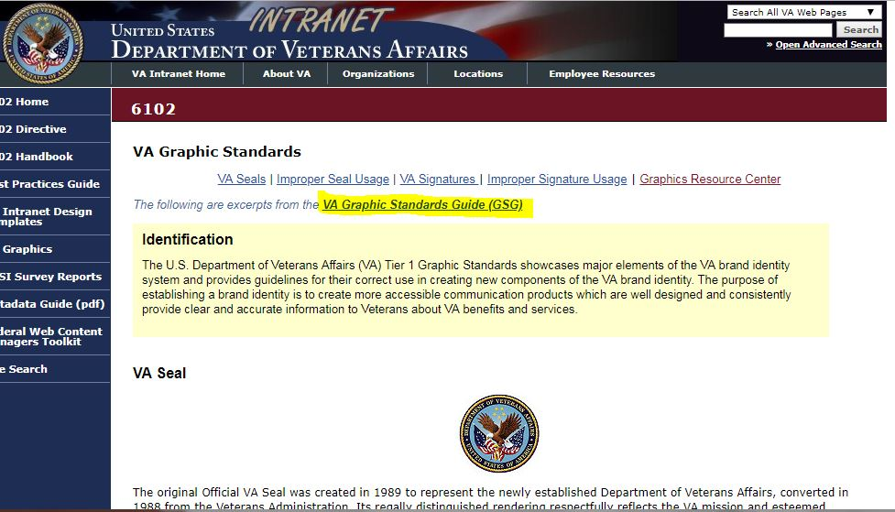
Goes here: https://vaww.va.gov/6102/VA_Graphic_Standards.asp

Slide 16
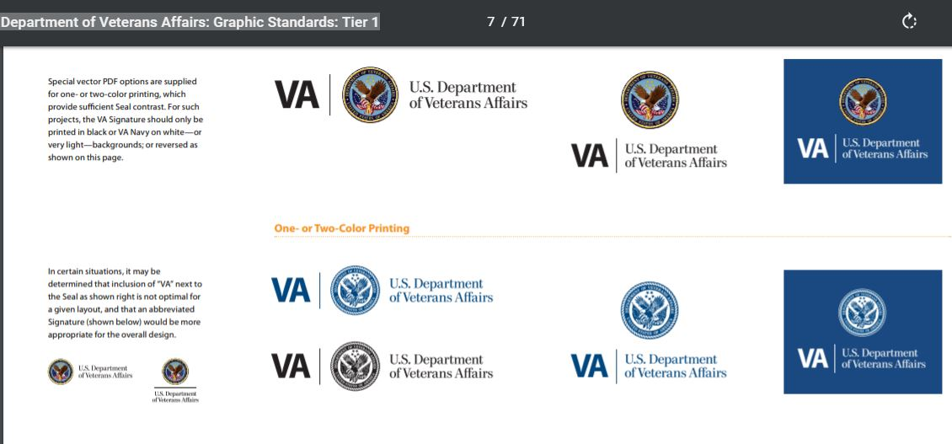
Which goes here: https://vaww.va.gov/6102/graphicstandards/VA_508_GraphicStandardsGuide_013113.pdf U.S. Department of Veterans Affairs: Graphic Standards: Tier 1 (Version 1.0 August 2012)
Brand visual elements
Logos, graphics
Colors, typography
Photography guidelines
But no word list

